Slide 1


Tutorial: Communication Protocol Customization CustomPro
Part 2

Slide 2





GWU TPCP Team
Yurong Chen
PhD, Security@FB
gabrielchen@email.gwu.edu
Kailash Gogineni
PhD Candidate
kailashg26@gwu.edu
Yongsheng Mei
PhD Candidate
ysmei@gwu.edu
Guru Venkataramani
PhD, PI
guruv@gwu.edu
Tian Lan
PhD, PI
tlan@gwu.edu
DIALECT (N00014-17-1-2786)
Communication Protocol Customization via Feature DIAgnosis, Lacing, Elimination, Crossgrafting, and Trimming

Slide 3
Outline
Introduction
Tool: CustomPro - Tainted results for OpenSSL
Address translation
Symbolic execution with angr
Binary rewriting - dyninst
Dyninst
Mutator & Mutatee
Script

Slide 4
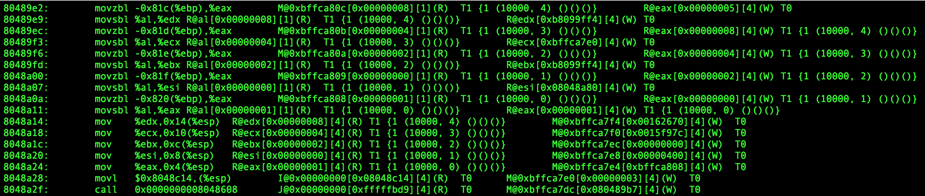
Analyzing tainting results
Use Vine to interpret the instruction trace file generated by TEMU, then use the script taint_analyze.py to extract tainted instructions.
The first field is the address of the instruction, and after that comes its disassembly in GNU/AT&T format. Then the rest of the record describes the operands to the instruction, and their types of taint. "R“ and "M" stand for register and memory values respectively; other possibilities include "I" for an immediate value, "J" for a jump target, "F" for a floating point register, and "A" for an address. The location of the operand comes after the "@" sign, then its value inside the first set of square brackets and its size in bytes in the second set. If an operand is untainted, it's followed by T0; if it’s tainted, it's followed by T1 and then a list of up to 4 taint sources, each of which is a pair of integers representing an origin and an offset.
trace_reader -trace TRACE_FILE && taint_analyze.py TRACE_FILE

Slide 5
Steps to follow:
1. We start with the tainting result and dumped program binary of OpenSSL.
2. Generate a list of all basic blocks (denoted by L) of function x.
3. Use basic block mapping to find the offset value.
4. Based on the offset value, check if each basic block in list L has tag T1 in the tainting result, and if so, mark it as tainted in L accordingly.
5. Symbolic execution of each tainted basic block in list L. Any new basic block executed during the process will also be marked as tainted in L.
6. Rewrite all tainted basic blocks in L.

Slide 6
Address translation
Address Translation (AT) is a method of remapping an Instruction address to another by modifying network address information
Example: suppose addresses in a basic block in binary:
Note:The the difference is the offset, the OS controls that at runtime, like it loads wherever the space is available.
For OpenSSL, we map the function using start: “080de670 <md5_block_asm_data_order>:” and end: “80ded17” from the dump of OpenSSL binary (objdump -d binary_name) to the tainted result.
1000
1002
1005
1006
2000
2002
2005
2006
this relocates to

Slide 7
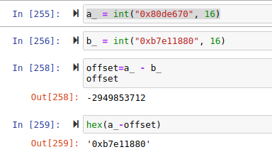
Address translation
We note that there are 6 basic blocks inside the function “080de670 <md5_block_asm_data_order>:”.
We also calculate the offset to make sure it is constant across the function “080de670 <md5_block_asm_data_order>:”
Example of offset:
Here, a_ is the address of binary
b_ is the address of tainted binary
We calculate the offset using a_ - b_ which gives us the computed result.
Using the offset result we can map it to the other basic blocks in the function.
So, once we have an address of basic block from binary of OpenSSL, we can locate the same basic block in tainted binary using the offset.
Note: The offset value is same for all the instructions in a function.

Slide 8
Script for the offset calculation:
We provide sample scripts to demonstrate how to find offset for matching the function and identifying the basic blocks in the function.
Programming language: Python, run the .ipynb file using jupyter notebook to visualize.
System: Ubuntu 19.10 64 bit, Intel® Core™ i7-4790S CPU @ 3.20GHz × 8
We shall need python3 to run the script for calculating the offset.
Refer to the complete source code:

Slide 9
Script for the offset calculation:
Code outline:
After tainting, we use the tainted binary of objdump binary of OpenSSL and load them.
We then use a specific function, say, “080de670 <md5_block_asm_data_order>:” as the starting point to compare that in the tainted binary in the linear order.
Then we observed that, 598 instructions (of the above function) are present in the above function and it matches to the OpenSSL tainted binary by giving us constant offset.
To run the script for calculating, pls open the address_translation_block.ipynb file using jupyter notebook and input the paths of dump binary and tainted binary respectively.

Slide 10
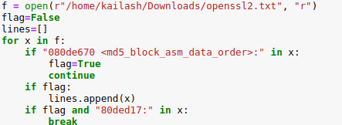
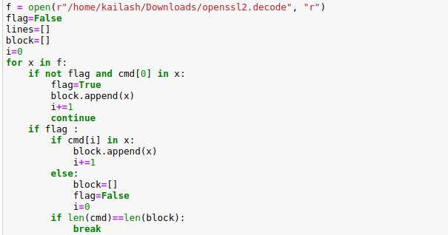
Script for the offset calculation:
Modifications need to verify offset calculation:
In this block we need to give the dump binary as the input.
The addresses highlighted in red color specifies the start and ending address we want to load.
The block which is loaded is compared to the tainted binary.
In this code block, we need to specify the tainted binary as the input.

Slide 11
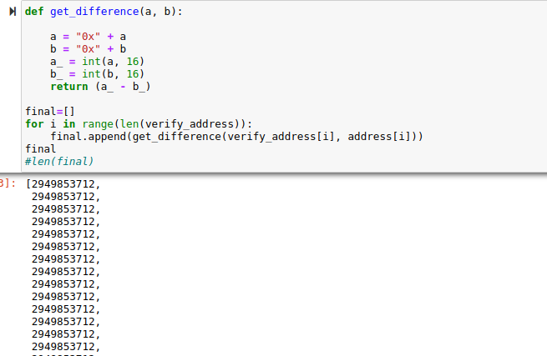
Script for the offset calculation:
Offset calculation result for function <md5_block_asm_data_order>:”
Note: Alll the 598 instructions in the above function have same offset.

Slide 12
Symbolic execution
Symbolic execution is a means of analyzing a program to determine what inputs cause each part of a program to execute.
We use angr (http://angr.io/) for the CustomPro.
We give an input as the basic block address and the angr explores the specific execution paths in the binary code dumps the instructions using history plugin.
We use Angr to perform symbolic execution on the static binary. The symbolic execution starts from the memory locations where packets are stored (which can be identified by the tainting information in CustomPro )
More results of using angr with OpenSSL for exploration and dump of instructions for the specific path of basic blocks can be found here:

Slide 13
Scripts
We provided sample script to demostrate how to use angr for symbolic execution.
Programming: Python3
System: Ubuntu 19.10 64 bit, Intel® Core™ i7-4790S CPU @ 3.20GHz × 8
We shall build the appropriate environment for angr.
Refer to URL: https://docs.angr.io/introductory-errata/install
ANGR is python library which can be installed using pip command.

Slide 14
Scripts
We perform the basic symbolic execution for OpenSSL binary using angr.
Step exeution using angr,
First, we need to load angr (import angr)
Next the project (OpenSSL) is loaded.
We set the start state, and we have project.factory.block(), which is used to extract a basic block of code from a given address. This is an important fact - angr analyzes code in units of basic blocks.
When you're performing execution with angr, you are working with a specific object representing a simulated program state - a SimState.
Then we create a simulation manager is the primary interface in angr for performing execution.
Now, we use .step() for performing basic block worth of execution.
Then if we .active the state gets changed in the stash.

Slide 15
Basic exeution angr
>>> import angr
>>> proj = angr.Project('/home/kailash/Downloads/openssl2') #loads the binary openssl
>>> proj
>>> proj.entry = 0x80de670 # give an entry point for the basic block
>>> block = proj.factory.block(proj.entry)
>>> block.pp() # the basic block displayed based on entry point address
>>> block.instructions # No.of instructions in the basic block
>>> block.instruction_addrs # No.of instructions with respect to their addresses is displyed
>>> state = proj.factory.entry_state() # When you're performing execution with angr, you are working with a specific object representing a simulated program state - a SimState
>>> state
>>> simgr = proj.factory.simulation_manager(state) # A simulation manager is the primary interface in angr for performing execution, simulation, whatever you want to call it, with states. First, we create the simulation manager we're going to be using. The constructor can take a state or a list of states.First, we create the simulation manager we're going to be using. The constructor can take a state or a list of states.
>>> simgr.active # look at the active state
>>> simgr.step() # we're going to do some execution.
>>> simgr.active # We've just performed a basic block's worth of symbolic execution! We can look at the active stash again, noticing that it's been updated, and furthermore, that it has not modified our original state. SimState objects are treated as immutable by execution - you can safely use a single state as a "base" for multiple rounds of execution.

Slide 16
Evaluation of results
We used “080de670 <md5_block_asm_data_order>:” function from dump binary and tainted binary (by pattern matching using offset) for doing the basic block execution.
We then collected 6 basic blocks after performing the basic symbolic execution.
The basic blocks are then passed onto the Dyninst tool for binary rewriting of the basic blocks.
Note: 6 basic blocks:
0x80de7a6
0x80de8b8
0x80de9cc
0x80deaea
0x80dec18
0x80ded12
These blocks are obtained after symbolic execution using the start address 0x80de694

Slide 17
Dyninst
Dyninst is a binary instrumentation tool.
Dyninst contains many useful APIs:
Dyninst API
Patch API
Parse API
Generally, Dyninst can be used to instrument a function and memory access, or instrument the code coverage.
In this implementation, after getting the execution path from symbolic execution, we will use Dyninst to rewrite a binary file.

Slide 18
Mutator & Mutatee
Mutator is written by user, which uses the API library to operate on the application.
Mutatee is the binary object we would like to instrument.
For CustomPro project:
Mutator: rewrite.cpp
Mutatee: openssl

Slide 19
Scripts
We provided sample scripts to demonstrate how to use Dyninst for binary rewriting.
Goal: Rewrite the specific basic block with nops (0x90).
Programming language: C++
System: Ubuntu 16.04 32bit
We shall build the appropriate environment for Dyninst.
Refer to URL: https://github.com/dyninst/dyninst.
Base on the property of binary we would like to instrument.

Slide 20
Scripts
Code outline:
Use bpatch.openBinary() to open original binary file.
Scan the binary and find out all the functions and basic blocks.
Locate the desired basic block with known address from symbolic execution.
Use defined function rewriteBlock() to rewrite the basic block.
Use writeFile() to write the instrumented binary into a new file.
The sample mutator rewrite.cpp and Makefile are provided.

Slide 21
Scripts
How to use scripts in terminal:
Compiling: Type $make in the directory where Makefile is located.
Running: Type $./rewrite to do the rewriting.
Checking: Type $objdump -d openssl-rewritten to check new binary.
How to modify variables in sample mutator:
Path[] (Line 38): Fill in addresses provided by symbolic execution path.
originalBinary (Line 58): Fill in name of input binary file we would like to instrument.
instrumentedBinary (Line 59): Fill in name of new output binary file.
You are encouraged to change the script for your personal usage!

Slide 22
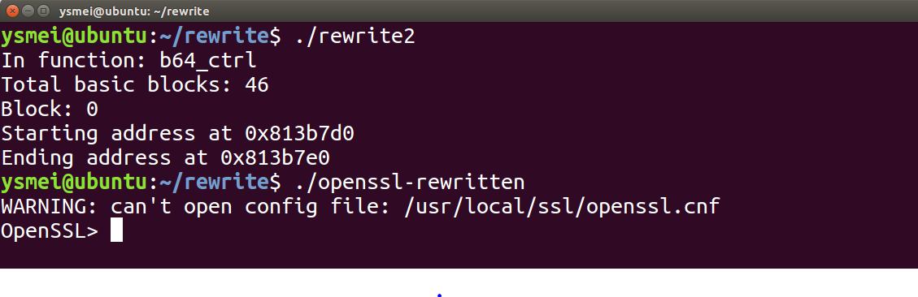
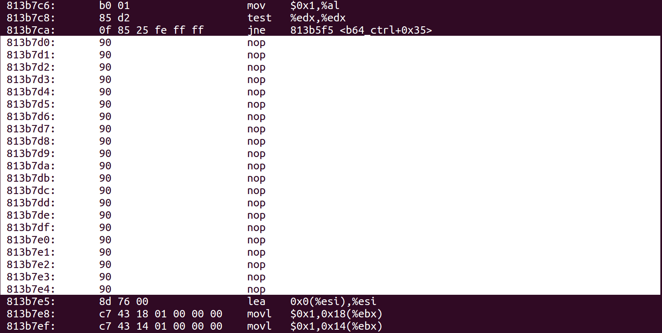
Scripts
Sample results
Mutator:
Name of mutator here is rewrite2.cpp.
Instrumented binary can be executed.
Instrumented binary:
One basic block get from symbolic execution path has been overwritten into nops.

